Slide 1
Chapter 14-Error Detection and Correction

Slide 2
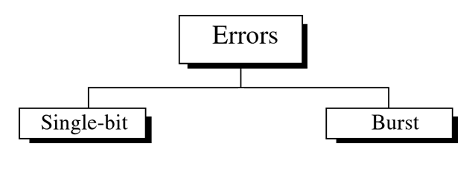
Introduction
Networks must be able to transfer data from one device to another with complete accuracy.
Data can be corrupted during transmission.
For reliable communication, errors must be detected and corrected.
Error detection and correction are implemented either at the data link layer or the transport layer of the OSI model.
Types of Errors

Slide 3
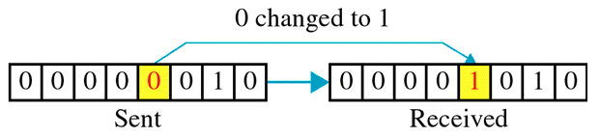
Single bit error
The term single bit error means that only one bit of a given data unit (such as a byte, character, data unit, or packet) is changed 1 to 0 or from 0 to 1.

Slide 4
Single bit error
Single-bit errors are the least likely type of error in serial data transmission. For example, imagine a sender sends data at 1 Mbps. This means that each bit lasts only 1µs. For a single bit error to occur, the noise must have a duration of only 1 µs, which is very rare; noise normally lasts much longer than this.
However, a single bit error can happen if we are sending data using parallel transmission. For example, if eight wires are used to send all of the eight bits of a byte at the same time and one of the wires is noisy, one bit can be corrupted in each byte.

Slide 5
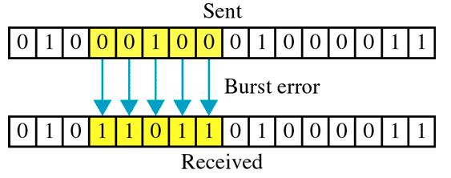
Burst Error
The term burst error means that two or more bits in the data unit have changed from 1 to 0 or 0 to 1.
Note that a burst error does not necessary mean that the errors occur in consecutive bits. The length of the burst is measured from the first bit to the last corrupted bit. Some bits in between may not have been corrupted.

Slide 6
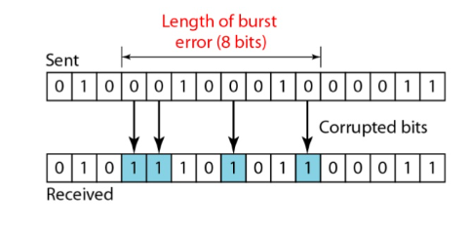
Burst Error
Burst error is most likely to happen in a serial transmission. The duration of noise is normally longer than the duration of a bit, which means that when noise effects data, it effects a set.
The number of bits affected depends on the data rate and duration of noise. For example, if we are sending at at 1Kbps, a noise of 1/100 seconds can effect 10 bits; if we are sending data at 1Mps, the same noise can affect 10,000 bits.

Slide 7
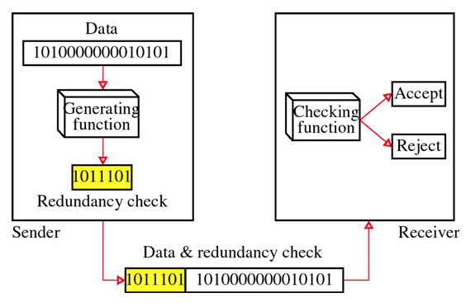
Detection
Error detection means to decide whether the received data is correct or not without having a copy of the original message.
Error detection uses the concept of redundancy, which means adding extra bits for detecting errors at the destination.

Slide 8
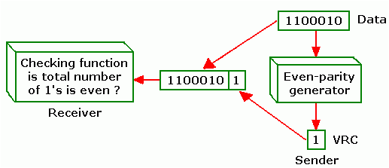
Vertical Redundancy Check
The most common and least expensive mechanism for error detection is the vertical redundancy check, often called a parity check.
Single bit is added to a block
Two schemes:
  Even parity – Maintain even number of 1s
    E.g., 1011 → 10111
  Odd parity – Maintain odd number of 1s
    E.g., 1011 → 10110

Slide 9
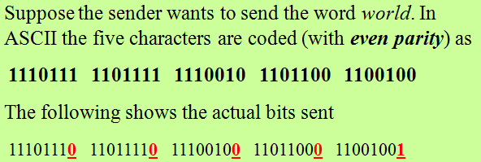
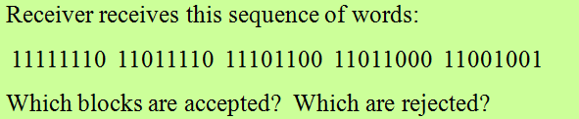
Vertical Redundancy Check Example

Slide 10
Vertical Redundancy Check Performance
VRC can detect all single-bit errors. It can also detect burst errors as long as the total number of bits changed is odd (1,3,5 etc.). Let’s say we have an even-parity data unit where the total number of 1s including the parity bit is 6: 1000111011. If any three bit change value, the resulting parity will be odd and the error will be detected: 1111111011:9, 0110111011:7, 1100010011:5-all odd. The VRC checker would return a result of 1 and the data unit would be rejected. The same holds true for any odd number of errors.

Slide 11
Vertical Redundancy Check Performance
Suppose however, that two bits of the data unit are changed: 1110111011:6, 1000011010:4. In each case the number of 1s in the data unit is still even. The VRC checker will add them and return an even number although the data unit contains two errors. VRC cannot detect errors where the total number of bits changed is even.

Slide 12
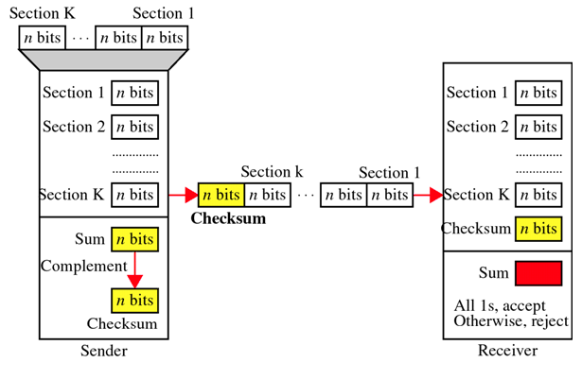
Checksum

Slide 13
Checksum-at the sender
The unit is divided into k sections, each of n bits.
All sections are added together using one’s complement to get the sum.
The sum is complemented and becomes the checksum.
The checksum is sent with the data
Checksum-at the receiver
The unit is divided into k sections, each of n bits.
All sections are added together using one’s complement to get the sum.
The sum is complemented.
If the result is zero, the data are accepted: otherwise, they are rejected.

Slide 14
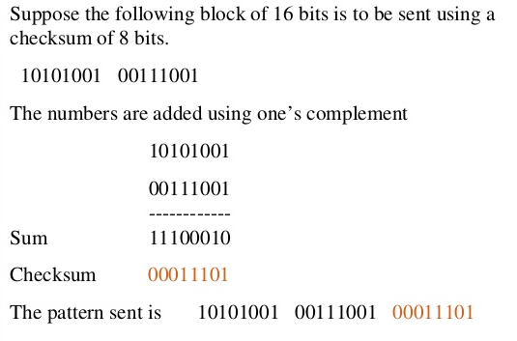
Checksum-example

Slide 15
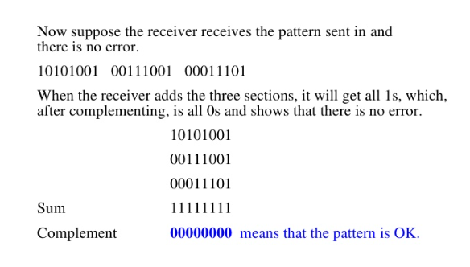
Checksum-example

Slide 16
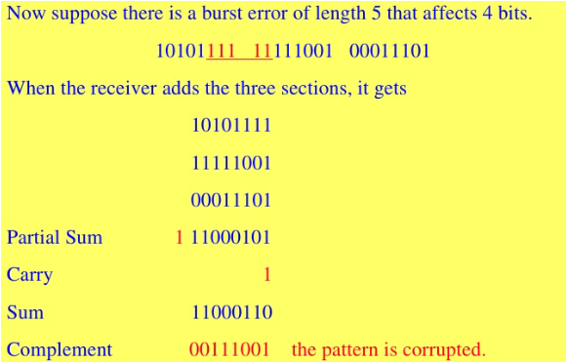
Checksum-example

Slide 17
Cyclic Redundancy Check (CRC)
Although the two preceding schemes may sometimes be adequate at higher layers, in practice, a third and stronger kind of error-detecting code is in widespread use at the link layer: the CRC (Cyclic Redundancy Check), also known as a polynomial code.
Given a k-bit frame or message, the transmitter generates an n-bit sequence, known as a frame check sequence (FCS), so that the resulting frame, consisting of (k+n) bits, is exactly divisible by some predetermined number.
The receiver then divides the incoming frame by the same number and, if there is no remainder, assumes that there was no error.

Slide 18
Cyclic Redundancy Check (CRC)
Although the two preceding schemes may sometimes be adequate at higher layers, in practice, a third and stronger kind of error-detecting code is in widespread use at the link layer: the CRC (Cyclic Redundancy Check), also known as a polynomial code.
Given a k-bit frame or message, the transmitter generates an n-bit sequence, known as a frame check sequence (FCS), so that the resulting frame, consisting of (k+n) bits, is exactly divisible by some predetermined number.
The receiver then divides the incoming frame by the same number and, if there is no remainder, assumes that there was no error.

Slide 19
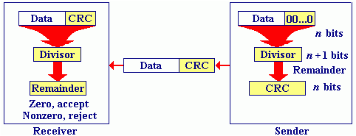
Three Basic Steps of deriving CRC
First, a string of n 0s is appended to the data unit. The number n is one less than the number of bits in the predetermined divisor, which is n+1 bits.
Second , the newly elongated data unit is divided by the divisor using a process called binary division. The remainder resulting from this division is the CRC.
Third , the CRC of n bits derived in step 2 replaces the appended 0s at the end of the data unit.
Note that the CRC may consists of all 0s.

Slide 20
CRC Receiver
The data unit arrives at the receiver data first, followed by the CRC.
The receiver treats the whole string as a unit and divided it by the same divisor that was used to find the CRC remainder.
If the strings arrives without error, the CRC checker yields a remainder of zero and the data unit passes.
If the string has been changed in transit, the division yields a non-zero remainder and the data unit does not pass.

Slide 21
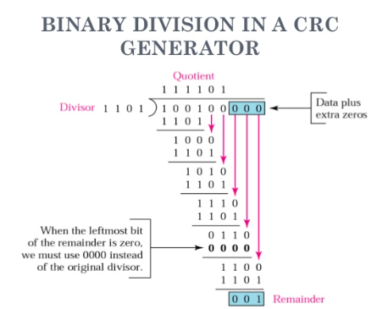
The CRC Generator
The CRC generator uses modulo-2 divisions.
A string of n 0s is added to the data unit. The number n is one smaller than the number of bits in the fixed divisor.

Slide 22
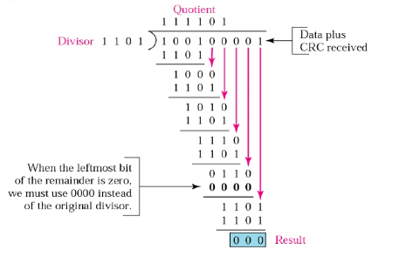
The CRC Checker

Slide 23
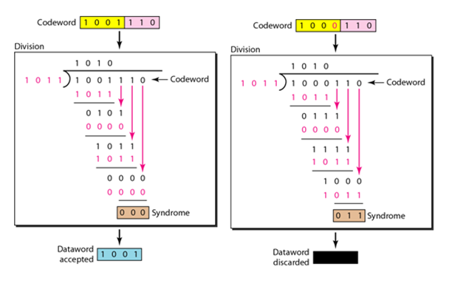
The CRC Generator and Checker

Slide 24
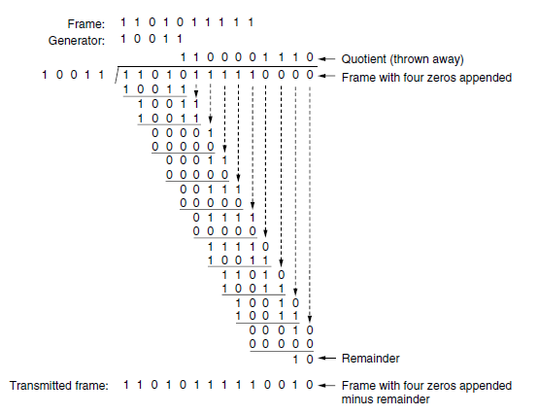
The CRC Generator

Slide 25

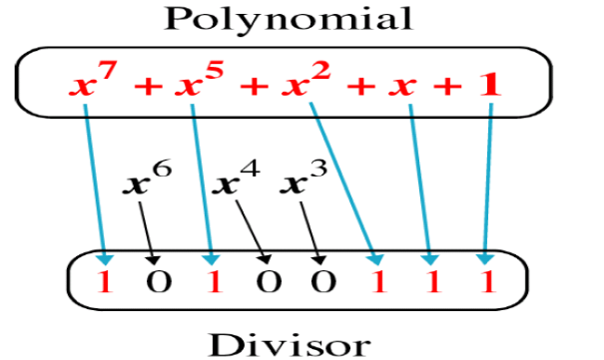
Polynomials
The CRC generator is often represented not as a string of 1s and 0s but as an algebraic polynomial.
The relationship of a polynomial to its corresponding binary representation is shown below:

Slide 26
Polynomials
A polynomial should be selected to have at least the following properties:
It should not be divisible by x
It should be divisible by (x+1)
The first condition guarantees that all burst errors of a length equal to the degree of the polynomial are detected.
The second condition guarantees that all burst errors affecting an odd number of bits are detected.

Slide 27
Polynomials
We cannot choose x (binary 10) or x²+x (binary 110) as the polynomial because both are divisible by x.
We can choose x+1 (binary 11) because it is not divisible by x but is divisible by x+1.
We can also choose x²+1 (binary 101) because it divisible by x+1 (binary division)

Slide 28
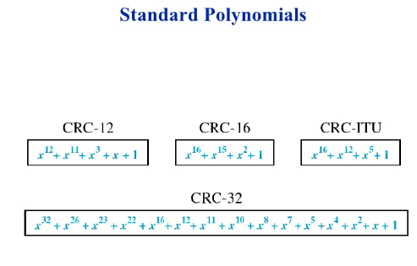
Polynomials
The standard polynomials used by popular protocols are shown below:
The numbers 12, 16 and 32 refers to the size of the CRC remainder. The CRC divisors are 13, 17 and 33 bits respectively.

Slide 29
Longitudinal Redundancy Check (LRC)
In LRC, a block of bits is organized in a table(rows and columns). For example, instead of sending a block of 32 bits, we organize then in a table made of four rows and eight columns.
We then calculate the parity bit for each column and create a new row of eight bits, which are the parity bits for the whole block.
The first parity bit in the fifth row is calculated based on all first bits. The second parity bit is calculated based on all second bits, and so on.
We then attach the eight parity bits to the original data and send them to the receiver.

Slide 30
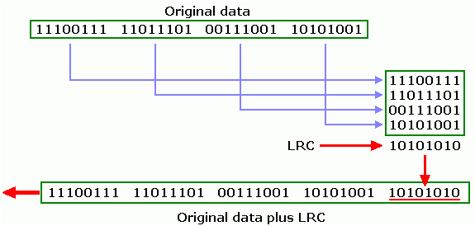
Longitudinal Redundancy Check (LRC)

Slide 31
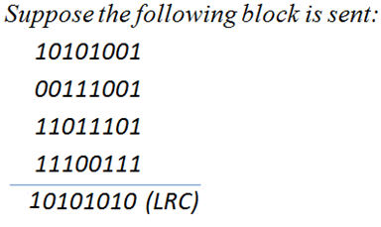
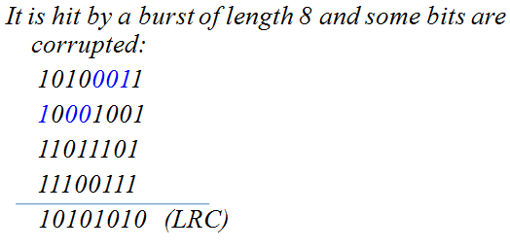
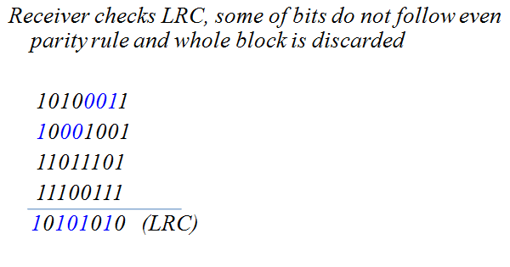
Example

Slide 32
Performance
LRC increases the likelihood of detecting burst errors.
An LRC of n bits can easily detect a burst error of n bits.
A burst error of more than n bits as also detected by LRC with a very high probability.
There is , however, one pattern of errors that remains elusive. If a bit of one data unit is damaged and another bit in exactly the same position in another data unit is also damaged, the LRC checker will not detect any error.

